Slide 1
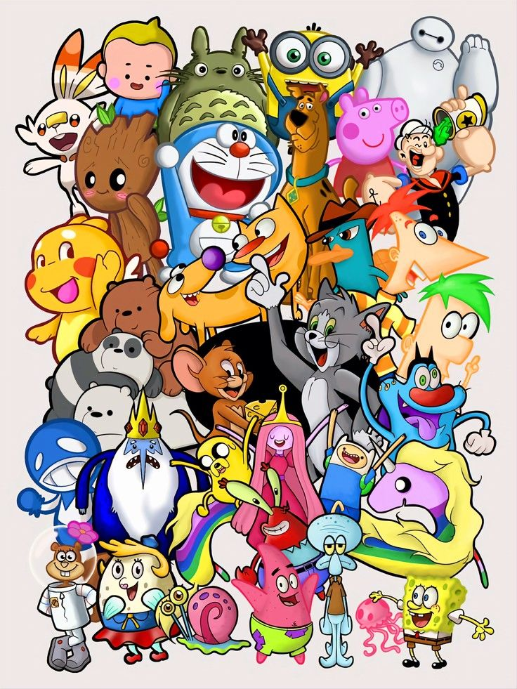
TASK-04
ANIMATIONS

Slide 2

DEMOGRAPHIC
INFORMATION
NAME : Aarthi
AGE : 15
GENDER : Female
LOCATION : Jammu
OCCUPATION : Student
EDUCATION : 9th

Slide 3
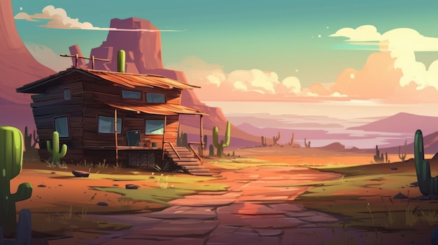
GOAL :
To Create engaging and imaginative world and characters
OBJECTIVE :
These are the animated shows which are dealed to
attract children . The real objective of animation is to
entertain and educate viewers by creating joyfull
characters and to improve moral values .

Slide 4
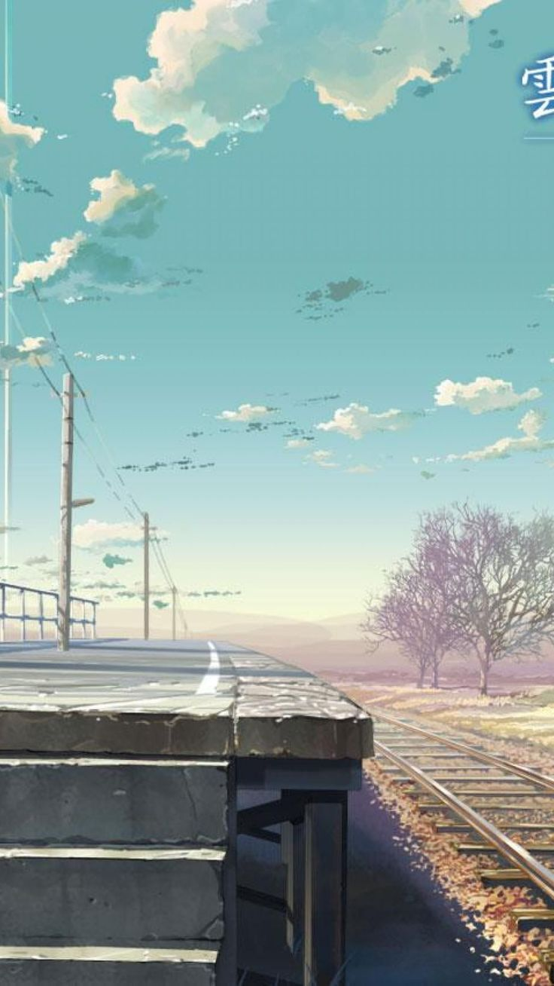
PSYCHOGRAPHIC
INFORMATION :
This involves diving into the preferences , values ,
attitudes , and lifestyle of the audience . Michelle
Connolly emphasises that “psychographic data is
key to creating animations that not only reach the
target audienc but truly speak to them on a
personal level .

Slide 5

INTEREST:
Animators and multimedia artists typically have
The following interests :They like work activities
That deal with artistic forms,designs,and patterns.
They prefer work which allows for self expression

Slide 6

BEHAVIOUR:
MORAL LESSONS:
Cartoons can teach moral and ethical lessons
Can shape viewers perceptions .
CHARACTERS:
Characters like superman and batman can
Inspire children to be brave and just,while can
Serve as a warning about the consequences
Of evil .

Slide 7

USER REVIEW:
Animation captivates users attention,guiding them through interfaces and drawing focus to
Important elements.whether it’s a subtle hover
Effect, a smooth transition between screens,or an animated loading indicator,well-executed
Animations capture user’s interest and encourage .

Slide 8

CHALLENGES:
Technical issues
Planning and storyboardind
Timing and spacing
Crafting a compelling story
Nonlinear movement

Slide 9

FEEDBACK:
Start by pointing out
Something positive
About the animation,such
As what you liked ,what
Impressed you,or what woked
Well.Then ,give some constuctive
Critcism,such as what could be
Improved , what didn’t make sense,or
What was distracting .

Slide 10
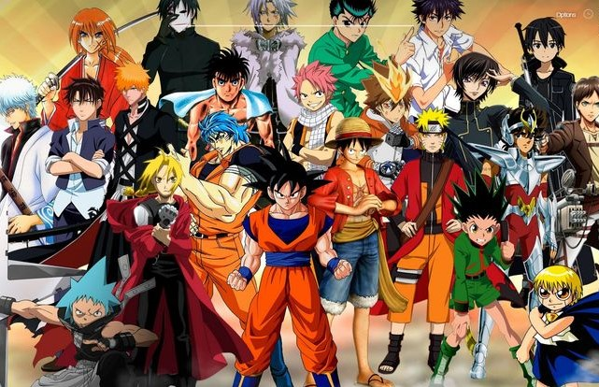
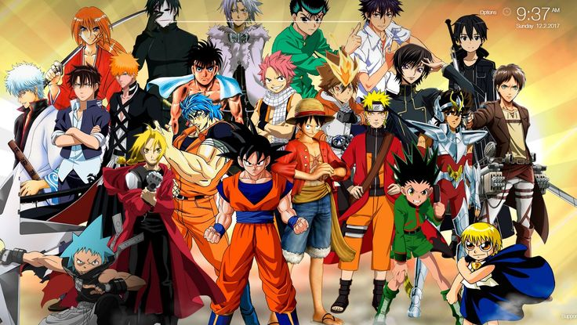
THANK YOU
TEAM CRITICAL THINKERS
T.RISHIKA
K.VAISHNAVI
V.MANASWANI DEVI
V.TEJASWINI
Y.AVANTHIKA

